Slide 1
Comparing Novel Approaches to Subgroup Analyses in Clinical Trials
Marius Thomas, Björn Bornkamp
JSM 2016
Chicago, July 31st 2016

Slide 2
Outline
Motivation
The common approach in exploratory subgroup analyses
Three approaches to adjust treatment effect estimates
Model averaging
Resampling
Lasso
Simulation Study
This work was supported by funding from the European Union's Horizon 2020 research and innovation programme under the Marie Sklodowska-Curie grant agreement No 633567 and by the Swiss State Secretariat for Education, Research and Innovation (SERI) under contract number 999754557. The opinions expressed and arguments employed herein do not necessarily reflect the official views of the Swiss Government.

Slide 3
The Setting
Exploratory subgroup analysis
Routinely performed in early phase (e.g. proof-of-concept, Phase IIa/b studies) but also on an exploratory basis in late stage trials
Characteristics:
Sample size:
Studies not powered for comparisons in subgroups
Pre-specification of subgroups?
Usually a list of subgroup defining covariates is pre-defined
Number of analysed subgroups?
~5-30

Slide 4
Standard model
Statistical model for normally distributed endpoints
Subgroup analysis model
${ y}_{i} \sim N\left(μ_{i}, σ^{2}\right)$, i=1, ..., n
$$μ_{i}=β_{0}+β_{2}s_{i}+{(β}_{1}+β_{3}s_{i})T_{i}$$
$μ_{i} −$ Mean response of patient i
$T_{i} −$ Treatment indicator
$s_{i} −$ Subgroup indicator (1 in the subgroup, 0 in the complement)
$β_{0} −$ Placebo effect
$β_{1} −$ Treatment effect
$β_{2} −$ Prognostic effect of subgroup (independent of treatment)
$β_{3} −$ Predictive effect of subgroup (change in the treatment effect)
One model for each subgroup indicator

Slide 5
Subgroup analyses
Common approach for identifying subgroups
$y_{i} \sim N\left(μ_{i}, σ^{2}\right)$, i=1, ..., n
$$μ_{i}=β_{0}+β_{2}s_{i}+{(β}_{1}+β_{3}s_{i})T_{i}$$
For all potential K subgroups (i.e. subgroup indicators)
fit model and obtain treatment effect in subgroup: $\hat{β_{1}^{(k)}}+\hat{β_{3}^{(k)}}$ and p-value for testing $β_{3}^{(k)}=0$ („interaction test“)
Choose model/subgroup, based on
magnitude of $\hat{β_{1}^{(k)}}+\hat{β_{3}^{(k)}}$for different subgroups k
on the p-value for the interaction test
Naive estimates $\hat{β_{1}^{(k)}}+\hat{β_{3}^{(k)}}$ for selected subgroups will be overly optimistic due to selection bias!

Slide 6
Adjusting treatment effect estimates
Three approaches
Formal bias-adjustment very difficult
Three alternative approaches:
Model Averaging (Berger et al., 2014)
Bayesian approach using weighted average over all considered models
Resampling (Sun and Bull, 2005)
Using independent samples to estimate selection bias
3. Lasso regression (Tibshirani, 1996)
Use lasso model to predict individual treatment effects for patients

Slide 7
Model averaging
Motivated from Bayesian ideas
Idea: View subgroup selection as model selection
Each subgroup defines a different statistical model
Picking one model (e.g. with high or the highest (standardized) treatment effect) ignores model uncertainty
Equivalent to setting the posterior model probabilities to 1 for one model and 0 for all others
Use weighted inference based on the posterior model probabilities for each model/subgroup

Slide 8
Model averaging
In a subgroup analysis setting
Assume a set of K candidate subgroups is pre-specified
Candidate subgroups s⁽¹⁾, ..., s^{(K)}
These correspond to K candidate models M₁,..., M_{K}
the k-th model is given by
y_{i} ~ N(μ_{i}^{(k)},σ^{(k)2})
μ_{i}^{(k)} = β₀^{(k)} + $β_{2}^{(k)}s_{i}^{(k)}+(β_{1}^{(k)}+β_{3}s_{i}^{(k)})T_{i}$
with prior distributions for β₀^{(k)}, β₁^{(k)}, β₂^{(k)} β₃^{(k)} and σ^{(k)2}
and prior model probabilites for M₁,..., M_{K}

Slide 9
Model averaging
In a subgroup analysis setting
The treatment effect for a selected subgroup can be estimated under all models
For subgroup s^{(k)} under model M_{k}
Treatment effect in subgroup: $β_{1}^{(k)}+β_{3}^{(k)}$ (naive estimate)

Slide 10
Model averaging
In a subgroup analysis setting
The treatment effect for a selected subgroup can be estimated under all models
For subgroup s^{(k)} under model M_{k}
Treatment effect in subgroup: $β_{1}^{(k)}+β_{3}^{(k)}$ (naive estimate)
For subgroup s^{(k)} under all other models M_{k‘} (with k‘ ≠ k):
Predict treatment effect for every patient in the subgroup
Treatment effect in subgroup: $β_{1}^{(k′)}+w_{{k,k}^{′}}β_{3}^{(k′)}$
$w_{k,k^{′}}∈[0,1]$ is the proportion of patients in subgroup k that are also in subgroup k‘

Slide 11
Model averaging
In a subgroup analysis setting
The treatment effect for a selected subgroup can be estimated under all models
For subgroup s^{(k)} under model M_{k}
Treatment effect in subgroup: $β_{1}^{(k)}+β_{3}^{(k)}$ (naive estimate)
For subgroup s^{(k)} under all other models M_{k‘} (with k‘ ≠ k):
Predict treatment effect for every patient in the subgroup
Treatment effect in subgroup: $β_{1}^{(k′)}+w_{{k,k}^{′}}β_{3}^{(k′)}$
$w_{k,k^{′}}∈[0,1]$ is the proportion of patients in subgroup k that are also in subgroup k‘
Then take the weighted average over all models with posterior model probabilities as weights
Amount of shrinkage depends on how posterior model probability is distributed across models

Slide 12
Resampling General Idea
Split data into training (identification) and test (estimation) sample by bootstrapping
Perform subgroup identification on the training data
Compare the treatment effect in the selected subgroup in the Identification and Estimation sample and adjust original estimate
Repeat this B times
Complete trial data:
Subgroup S was identified
$${\hat{δ}(S)}_{}$$
Split B times
Id. sample:
Identify a subgroup $S^{(b)}$
Est. Sample:
Estimate effect for $S^{(b)}$
$${\hat{δ}}_{I}\text{(}S^{(b)})$$
$${\hat{δ}}_{E}\text{(}S^{(b)})$$
$${\hat{δ}}_{adj}\text{(}S)$$

Slide 13
Resampling Three Estimators
Bias estimation (rsbias):
$\hat{δ}(S)−\frac{1}{B} \sum_{b=1}^{B}{[}{\hat{δ}}_{I}\text{(}S^{\left(b\right)})−{\hat{δ}}_{E}$($S^{(b)})$]
Complete trial data:
Subgroup S was identified
$${\hat{δ}(S)}_{}$$
Split B times
Id. sample:
Identify a subgroup $S^{(b)}$
Est. Sample:
Estimate effect for $S^{(b)}$
$${\hat{δ}}_{I}\text{(}S^{(b)})$$
$${\hat{δ}}_{E}\text{(}S^{(b)})$$
$${\hat{δ}}_{adj}\text{(}S)$$

Slide 14
Resampling Three Estimators
Bias estimation (rsbias):
$\hat{δ}(S)−\frac{1}{B} \sum_{b=1}^{B}{[}{\hat{δ}}_{I}\text{(}S^{\left(b\right)})−{\hat{δ}}_{E}$($S^{(b)})$]
.632 estimator (rs632):
(1-0.632) *$\hat{ δ}\left(S\right)+ 0.632 ∗\frac{1}{B}$ $\sum_{b=1}^{B}{[}{\hat{δ}}_{E}$($S^{(b)})$]
Complete trial data:
Subgroup S was identified
$${\hat{δ}(S)}_{}$$
Split B times
Id. sample:
Identify a subgroup $S^{(b)}$
Est. Sample:
Estimate effect for $S^{(b)}$
$${\hat{δ}}_{I}\text{(}S^{(b)})$$
$${\hat{δ}}_{E}\text{(}S^{(b)})$$
$${\hat{δ}}_{adj}\text{(}S)$$

Slide 15
Resampling Three Estimators
Bias estimation (rsbias):
$\hat{δ}(S)−\frac{1}{B} \sum_{b=1}^{B}{[}{\hat{δ}}_{I}\text{(}S^{\left(b\right)})−{\hat{δ}}_{E}$($S^{(b)})$]
.632 estimator (rs632):
(1-0.632) *$\hat{ δ}\left(S\right)+ 0.632 ∗\frac{1}{B}$ $\sum_{b=1}^{B}{[}{\hat{δ}}_{E}$($S^{(b)})$]
“model averaging inspired“ (rsma)
$\frac{1}{B}$ $\sum_{b=1}^{B}{[}{{\hat{δ}}_{I}}^{(b)}$(S$)$]
Complete trial data:
Subgroup S was identified
$${\hat{δ}(S)}_{}$$
Split B times
Id. sample:
Identify a subgroup $S^{(b)}$
Est. Sample:
Estimate effect for $S^{(b)}$
$${\hat{δ}}_{I}\text{(}S^{(b)})$$
$${\hat{δ}}_{E}\text{(}S^{(b)})$$
$${\hat{δ}}_{adj}\text{(}S)$$

Slide 16
Penalized multivariate regression: LASSO
Instead of fitting one model per subgroup, it is possible to fit multivariate models, with mean response
$$μ_{i}=β_{0}+\sum_{k}{β_{2,k}}x_{i}^{(k)}+(β_{1}+\sum_{k}{β_{3,k}}x_{i}^{(k) })T_{i}$$
This model can get unstable to fit (if n is small compared to K) and clearly it would be overfitting data
Use Lasso regression to shrink parameters (but not $β_{0}$ and $β_{1}$)
Shrinks some of the $β_{2,k}$ and $β_{3,k}$ to zero
Induces shrinkage to the overall treatment effect

Slide 17
Treatment effect estimate
How to obtain treatment effect estimate for a given subgroup?
Predict treatment effect for every patient in the subgroup based on the Lasso model
Average this over all patients in the subgroup
Shrinkage towards overall effect
Will be induced by the fact that many of the $β_{3,k}$ will be estimated to be 0 → the corresponding covariate for this subgroup will have no effect

Slide 18
Simulation Setup
Generate K (=5, 10, 30) covariates from independent N(0,1)- distribution
use empirical quantiles as cut-offs to generate subgroups
Model for outcomes$:$
$y_{i}={g(x}_{1,i})T_{i}$ + $ε_{i}$, $ε_{i}$ ~ N(0,1)
First covariate x1 is predictive, no prognostic covariates
Different functional forms for $g$: step function, linear, sigmoidal
Different effect sizes (delta) in subgroup modeled through g
Sample sizes n=50 and 500

Slide 19
Results from 5000 simulated trials
Bias for estimating the treatment effect in the selected subgroup (n=50)

Slide 20
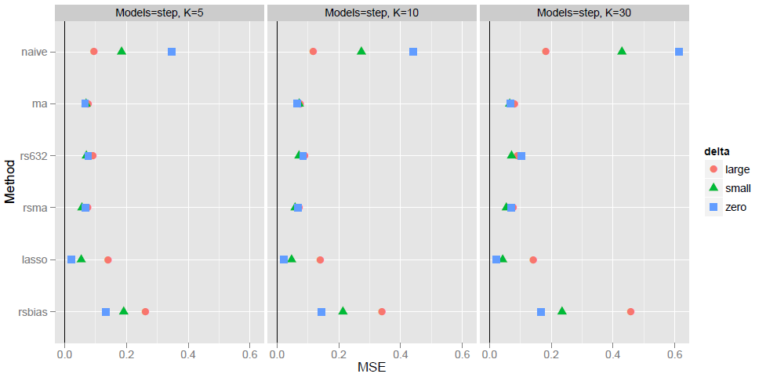
Results from 5000 simulated trials
MSE for estimating the treatment effect in the selected subgroup (n=50)

Slide 21
Conclusions
Naive treatment effect estimates for identified subgroups suffer from selection bias
We compared several different approaches to adjusted treatment effect estimation through extensive simulations
Several viable alternatives to naive estimates
Model averaging, Resampling (rsma, rs632), Lasso
Estimators have smaller biases, MSEs and better CI coverage under all considered scenarios

Slide 22
References
Berger, J. O., Wang, X. and Shen, L. (2014). A Bayesian approach to subgroup identification. Journal of Biopharmaceutical Statistics 24, 110-129
Sun, L. and S. B. Bull (2005). Reduction of selection bias in genomewide studies by resampling. Genetic Epidemiology 28, 352 -367.
Thomas, M. and Bornkamp, B. (2016). Comparing Approaches to Treatment Effect Estimation for Subgroups in Early Phase Clinical Trials. http://arxiv.org/abs/1603.03316
Tibshirani, R. (1996). Regression shrinkage and selection via the lasso. Journal of the Royal Statistical Society. Series B (Methodological) 58 (1), 267-288.

